Slide 1
HAIR|line
Salon Manager
A working prototype, built on eleven years of Hairline's own trading data.
Discovery
Plan
Live prototype
Prepared for the owner of Hairline Â· Shop 30, Stoneridge Centre, Greenstone Park
01

Slide 2
HAIR|line
THE BRIEF
Replace MySalon with something the team will actually use.
— Cover the whole salon — but keep it simple. No overkill.
— Focus on the core: invoicing, client history, pricing, stock, staff.
— Win buy-in from reception, the stylists and the owner.
— Build it properly — this could become a product for other salons.
THE TEST WE SET OURSELVES
The new till must be faster than the old one.
Every study of salon software adoption says the same thing: if checkout slows down, the team stops using it — whatever else the system can do.
02

Slide 3
HAIR|line
BEFORE DESIGNING ANYTHING
We restored the salon's database and read eleven years of it.
Not a workshop, not assumptions — the actual record of how Hairline trades, taken from the July 2026 MySalon backup.
90,183
INVOICES SINCE 2015
8,645
ACTIVE CLIENTS
R7.5m
REVENUE IN 2025
92
DATABASE TABLES READ
03

Slide 4
HAIR|line
WHAT THE DATA SAID
The salon told us what to build — and what to leave out.
Used every single day
Never used in 11 years
Invoicing
90,183 invoices
Payroll
0 records
Cash-up
3,841 daily counts
Loyalty points
0 records
Stock takes
49,663 items counted
Packages
0 records
Clocking in
11,069 records
Bank reconciliation
0 records
Tips & advances
4,478 records
Appointment diary
48 in 11 years
Every unused feature we leave out is a screen reception never has to learn.
04

Slide 5
HAIR|line
FOUR THINGS THE DATA REVEALED
Findings the salon can act on today.
01 — STOCK
1,350 lines show negative stock
Sales rung up against stock never received. Nearly 40% of the stock file cannot be trusted until it is counted.
02 — CLIENTS
758 clients have quietly lapsed
They visited within the year but not in 90 days. The cheapest revenue in the salon is a message to this list.
03 — PAYMENTS
89% of takings are on card
Cash is barely 5%. The cash-up ritual guards a small and shrinking share of the money.
04 — MARKETING
Only 8% have a birthday on file
718 of 8,645. Just 76 have an e-mail address, but 8,603 have a phone number — so SMS and WhatsApp, never e-mail.
05

Slide 6
HAIR|line
THE DECISION
Build the daily essentials exceptionally well.
Leave out everything the salon has already voted against.
Invoicing & cash-up
Clients & history
Pricing & menus
Stock control
Staff portfolios
Client messaging
A light diary
06

Slide 7
HAIR|line
WHAT CHANGES
Same rituals, twenty years of technology later.
MYSALON TODAY
SALON MANAGER
— One PC in the salon. If it dies, trading stops.
— SQL Server 2005 under the hood.
— Price menus retyped in Word every year.
— Figures only visible at reception.
— Dated SMS; no WhatsApp.
— Cloud-hosted, with a till that keeps working offline.
— A modern web app on any device.
— Client menu generated from live prices.
— Takings on the owner's phone, anywhere.
— SMS now, WhatsApp next.
â†’
07

Slide 8
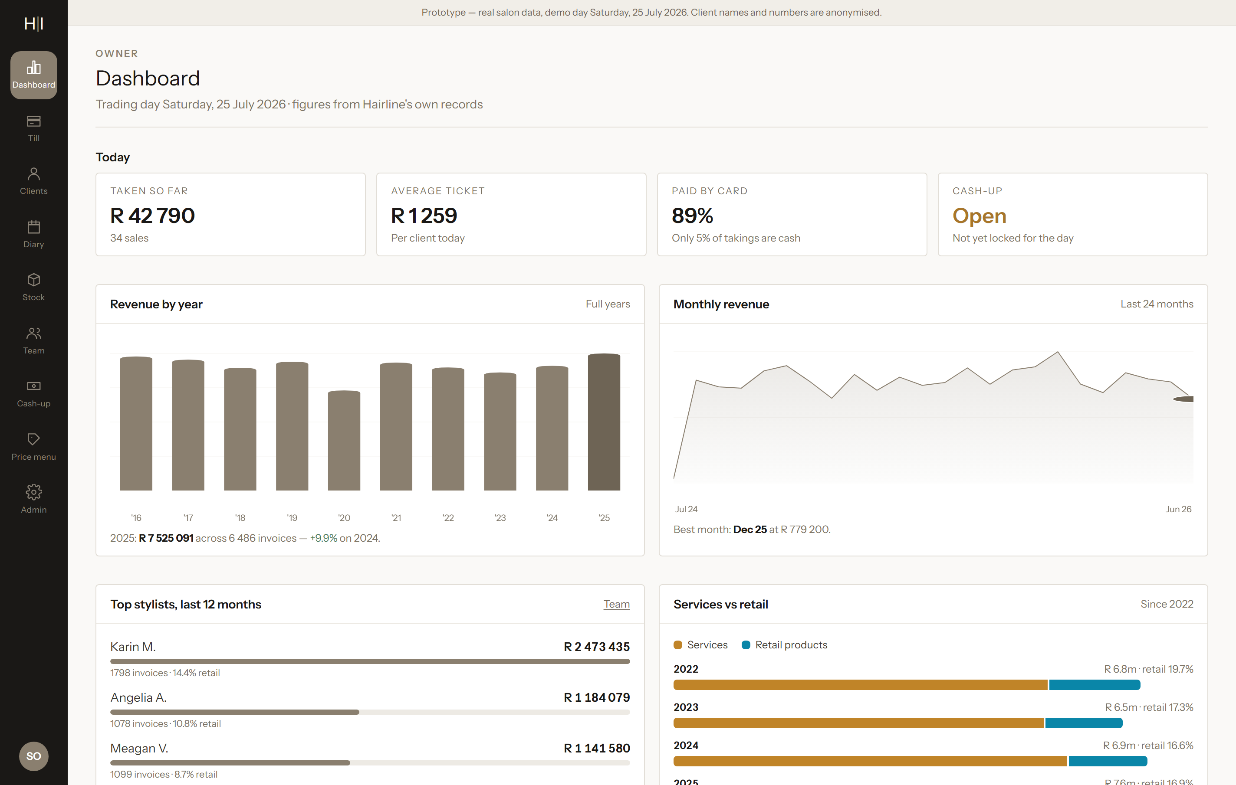
HAIR|line
NOT A MOCK-UP
We built it. It's running, on the salon's own data.
Eight working screens loaded with real services, real prices, real stock and eleven years of real visit patterns. Client names are anonymised; nothing else is invented.
750
CLIENT HISTORIES
228
SERVICES PRICED
2,494
STOCK LINES
08

Slide 9
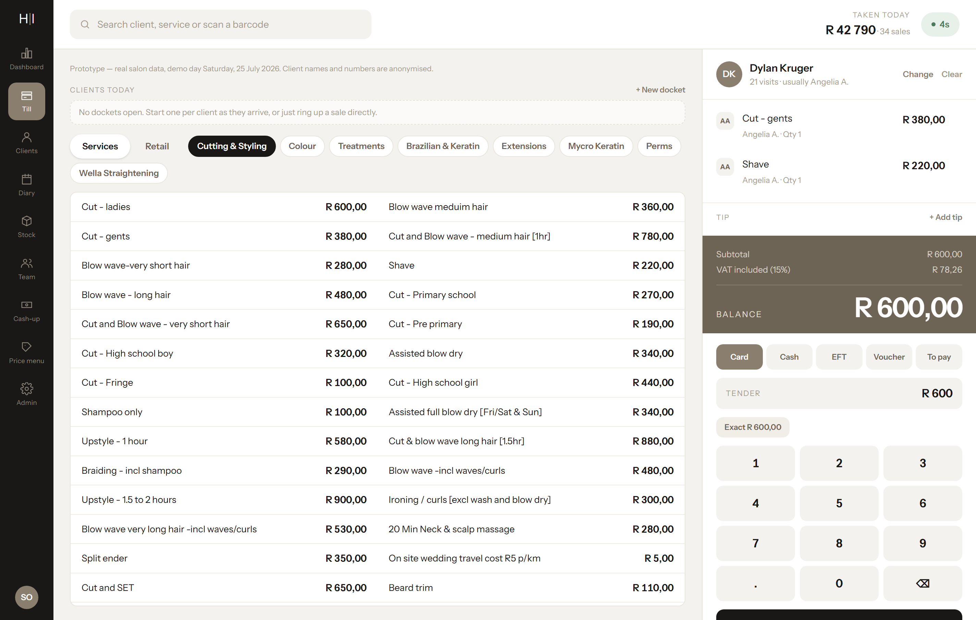
HAIR|line
THE SCREEN THAT DECIDES EVERYTHING
The till, with a stopwatch on it.
— One search finds a client, a service or a scanned barcode.
— Ordered by what you sell — the everyday services sit at the top.
— A docket per client, opened on arrival, settled at the counter.
— The balance owing is the largest thing on screen, keypad beneath it.
18 automated tests on the money logic
VAT, discounts, split payments, change and tips are each proven independently of the screen.
09

Slide 10
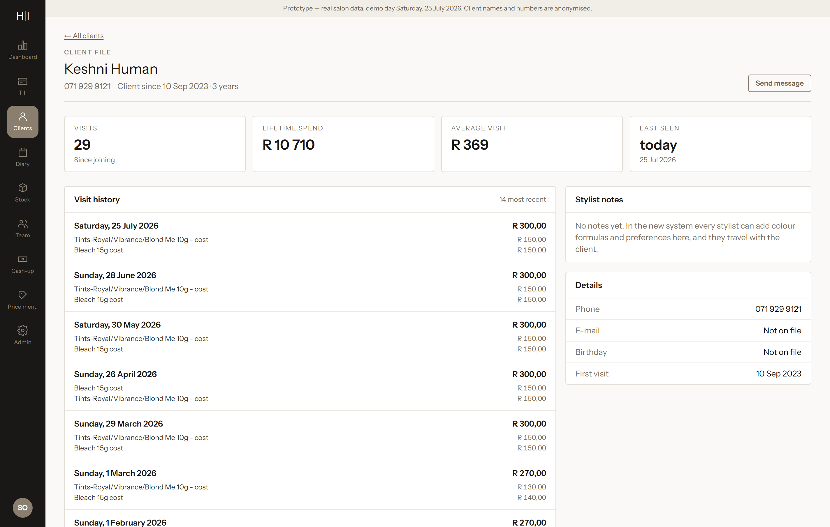
HAIR|line
THE SALON'S MOST VALUABLE ASSET
Every client, every visit, instantly.
— Search by name or phone; open a full timeline in one click.
— Every service and price back to 2015, with the stylist who did it.
— Colour formulas and medical flags travel with the client.
— Filters for lapsed clients, top spenders and birthdays.
1,709 clients have visited 10+ times
That loyal core is the business — and its history is locked in a 2005 database on one PC.
10

Slide 11
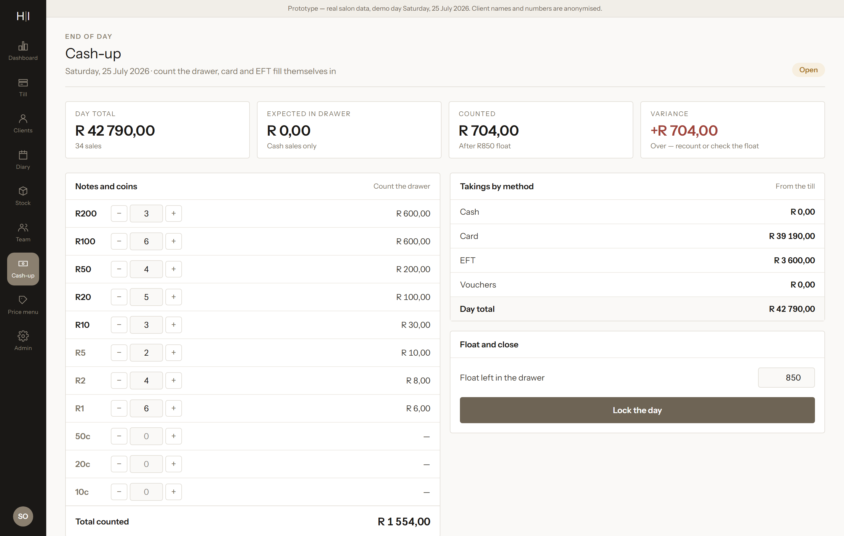
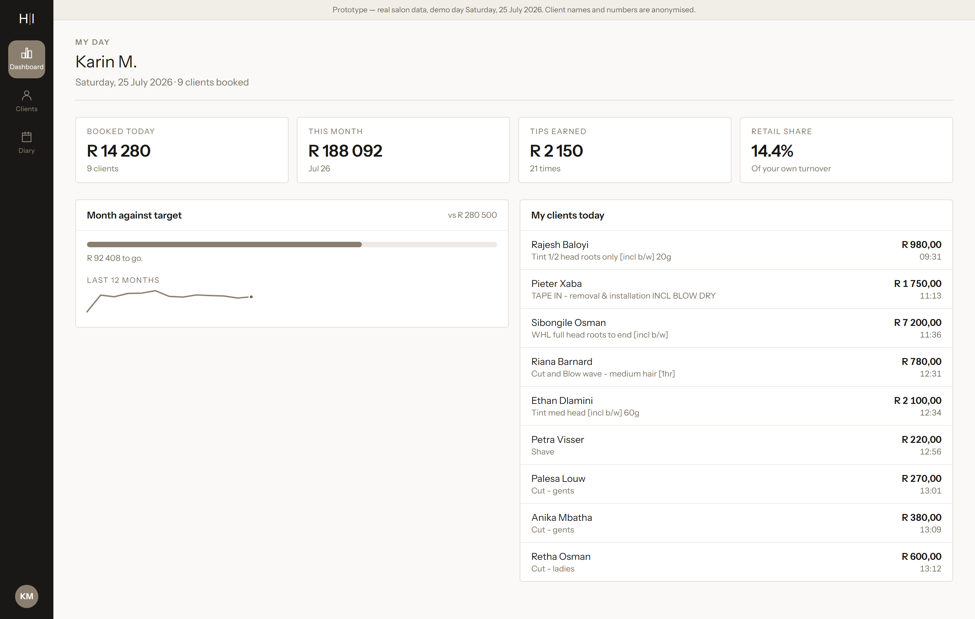
HAIR|line
BUY-IN BY DESIGN
Three people, three different systems.
OWNER
The business, on your phone
Takings so far today, month against last, top stylists, stock value and what needs attention — without phoning the salon.
RECEPTION
A faster front desk
Till, clients, diary, stock and the familiar denomination cash-up. No profit reports, no staff pay: less to learn.
STYLIST
Their own numbers
Today's clients, month against target and tips earned — on their own phone. Done for the team, not to them.
11

Slide 12
HAIR|line
GOING LIVE WITHOUT RISK
Nothing switches over until the numbers match.
Build the heart — Till, cash-up and clients, loaded with migrated data
6–8 weeks
Shadow run — The new till runs alongside MySalon; totals must match to the cent
2 weeks
Go live — Invoicing and cash-up cut over; MySalon becomes read-only
1 weekend
Stock & team — Stock control, orders, stock takes, portfolios, time clock
+4–6 weeks
Messaging & diary — SMS and WhatsApp templates, the light diary, stylist views
+3–4 weeks
Stylist dashboards arrive only after reception already trusts the till.
12

Slide 13
HAIR|line
HOW WE'LL KNOW IT WORKED
Five things, all of them measurable.
— A routine sale in 30 seconds or less, and cash-up done in five minutes.
— Shadow-run totals match MySalon to the cent, two weeks running.
— Reception say they prefer the new till within a month of go-live.
— The owner checks takings on their phone, instead of phoning the salon.
— Zero data loss — every historic visit still findable.
13

Slide 14
HAIR|line
OVER TO YOU
Try the prototype, then five decisions.
DECISIONS WE NEED
WHAT TO DO IN THE PROTOTYPE
— Sign in as owner — password hairline2026.
— Ring up a sale on the Till and watch the timer.
— Open a client and scroll eleven years of history.
— Sign out, back in as karin, to see a stylist's view.
— Count the drawer on Cash-up.
Name
Keep “Hairline Salon Manager”?
Price tiers
Confirm senior / junior levels
Card machine
Standalone, or integrated later?
WhatsApp
Register the salon number?
Diary
From day one, or ease into it?
This plan is a conversation starter, not a contract. Everything in it can change.
14

